Slide 1
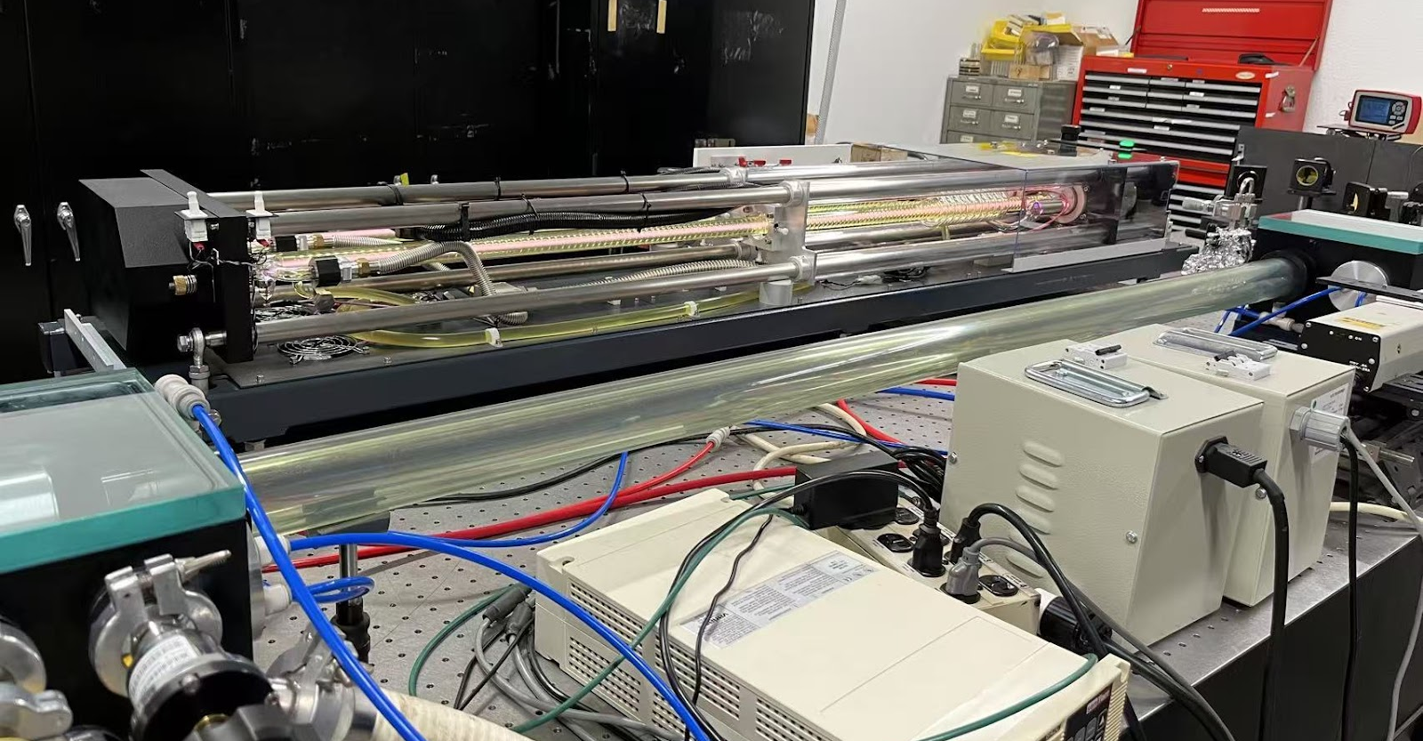
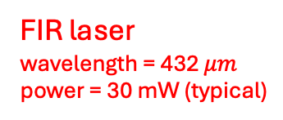

CO₂ laser
wavelength = 9.27 $μm$
power = 150 W
Feed-in system
CO₂ gas
CO₂ laser
Formic acid liquid flask
FIR laser
FIR laser
wavelength = 432 $μm$
power = 30 mW (typical)

Slide 2
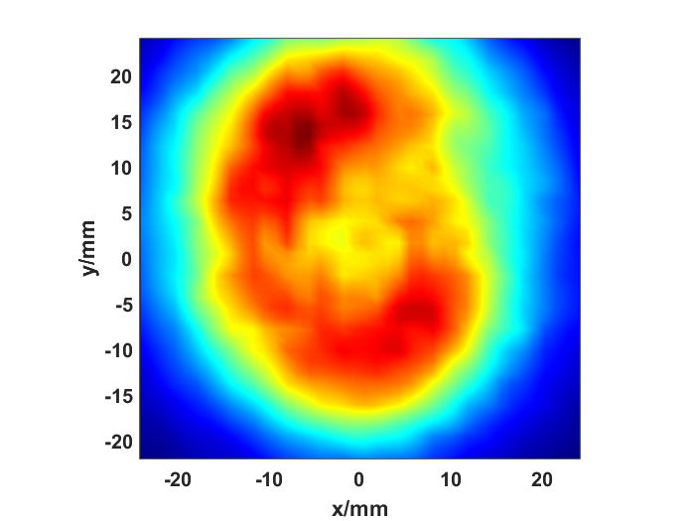
Feed-in system
CO₂ laser
CO₂ gas
Formic acid liquid flask
FIR laser
Beam propagation distance = 1 m
Terahertz camera
(GENTEC)

Slide 3
Feed-in system
CO₂ laser
CO₂ gas
Formic acid liquid flask
FIR laser
Beam propagation distance = 1 m
3D power detection platform

Slide 4
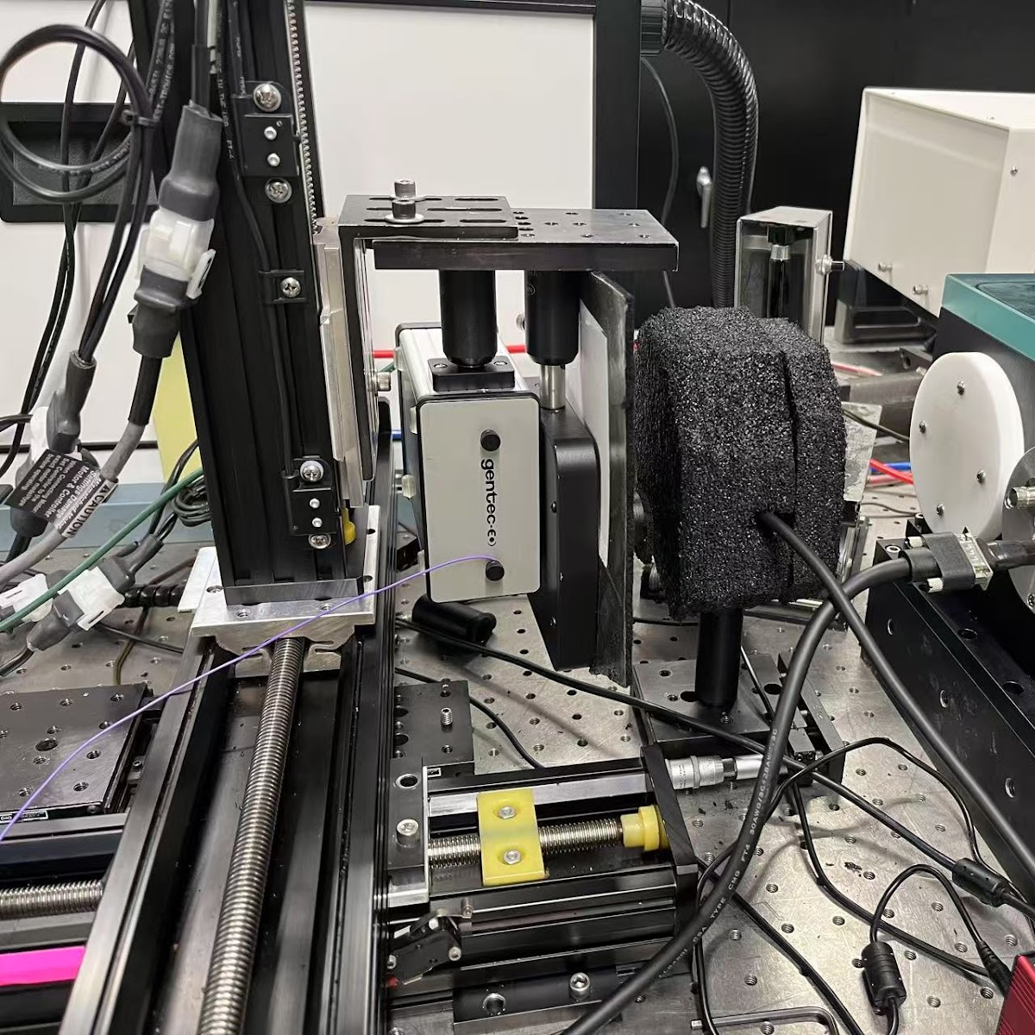
FIR power detector
(GENTEC)

Slide 8
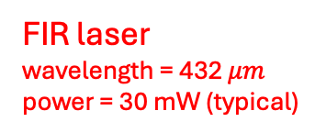
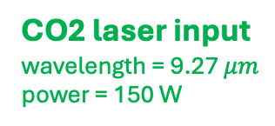
CO2 laser input
wavelength = 9.27 $μm$
power = 150 W
Formic acid liquid flask
FIR laser
wavelength = 432 $μm$
power = 30 mW (typical)
FIR laser
Laser cavity waveguide
CO₂ laser
Output window
Input window
Front mirror
Rear mirror
Metallic mesh

Slide 9
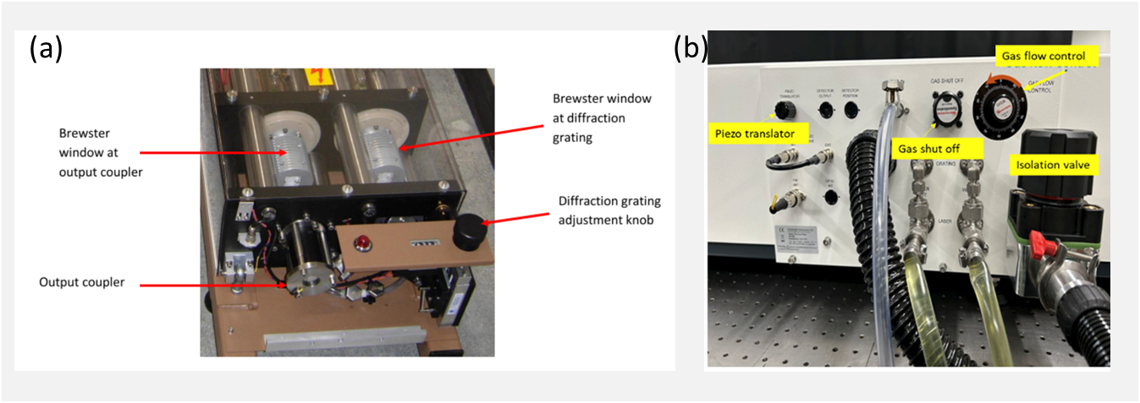
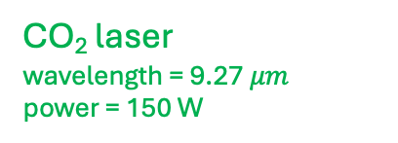
CO₂ laser
wavelength = 9.27 $μm$
power = 150 W
CO₂ gas
Brewster window
Laser cavity waveguide
Diffraction grating
CO₂ laser power supply
CO₂ laser output
Output aperture
Mirrors
Vacuum seal
Output coupler

Slide 10
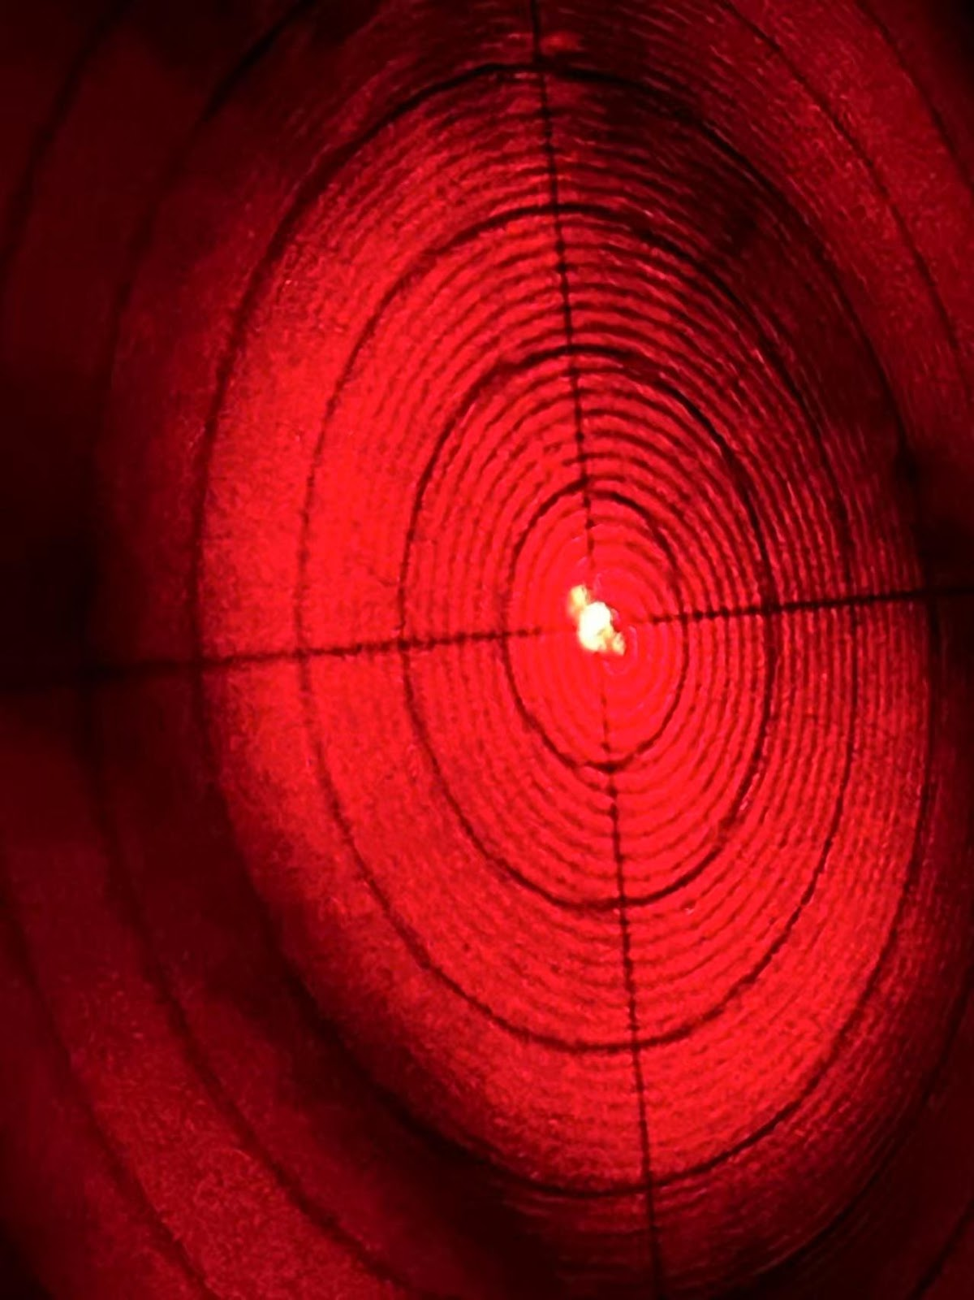
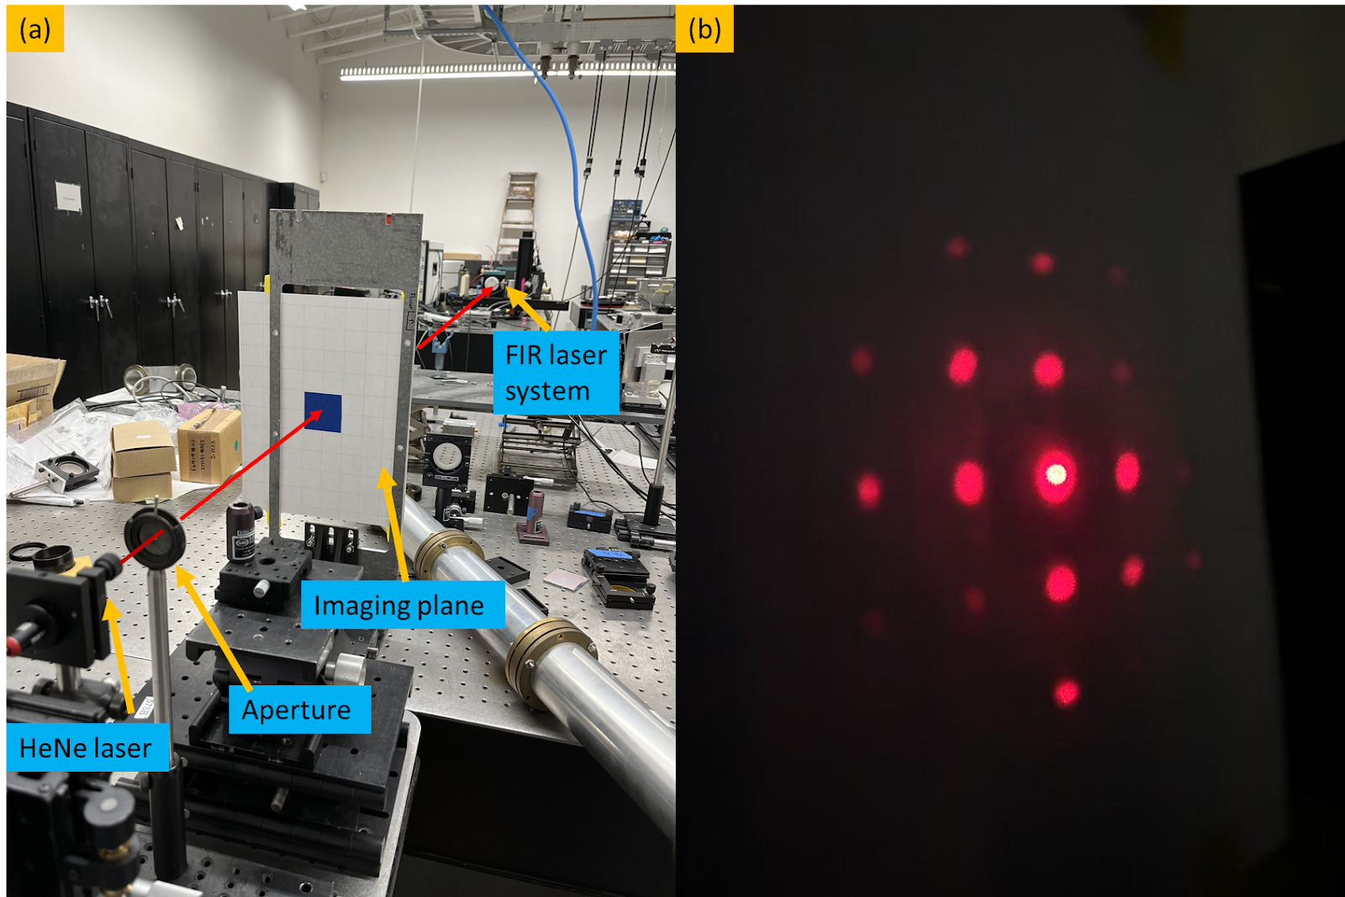
Fraunhofer diffraction ring
Diffraction by mesh
Aim center
Aim center

Slide 11
FIR laser
Laser cavity waveguide
CO₂ laser
Output window
Input window
Front mirror
Rear mirror
Metallic mesh

Slide 12
Setup the optical axis
HeNe laser
visible light (red)
Screen
Laser waveguide
Guide
Aperture
Guide
Image plane
Install laser components
④
③
②
①
④
Optical axis

Slide 13
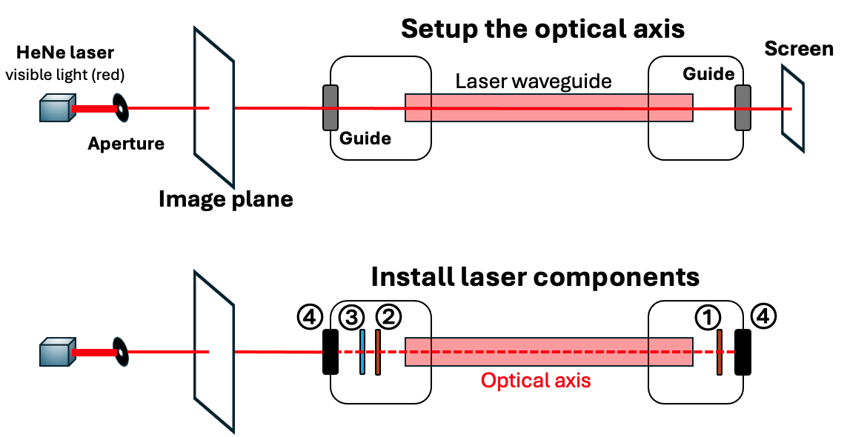
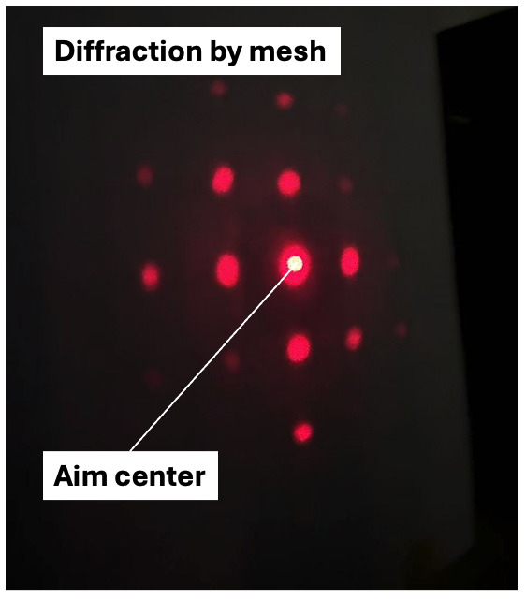
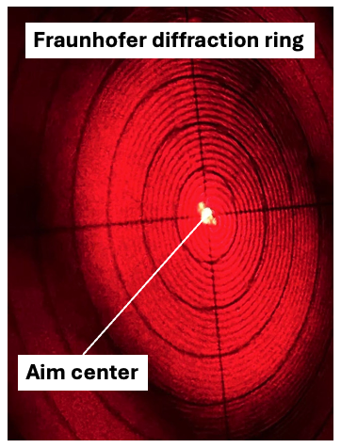
③
①

Slide 14
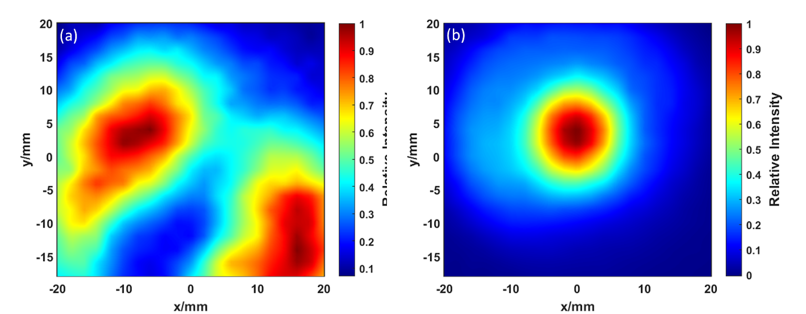
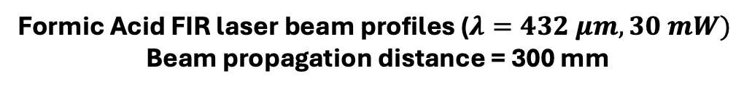
Formic Acid FIR laser beam profiles ($λ=432 μm, 30 mW)$
Beam propagation distance = 300 mm
Without alignment
With alignment
Optical axis
Optical axis
Normalized Power Intensity
Vertical position (mm)
Vertical position (mm)
Horizontal position (mm)
Horizontal position (mm)

Slide 15
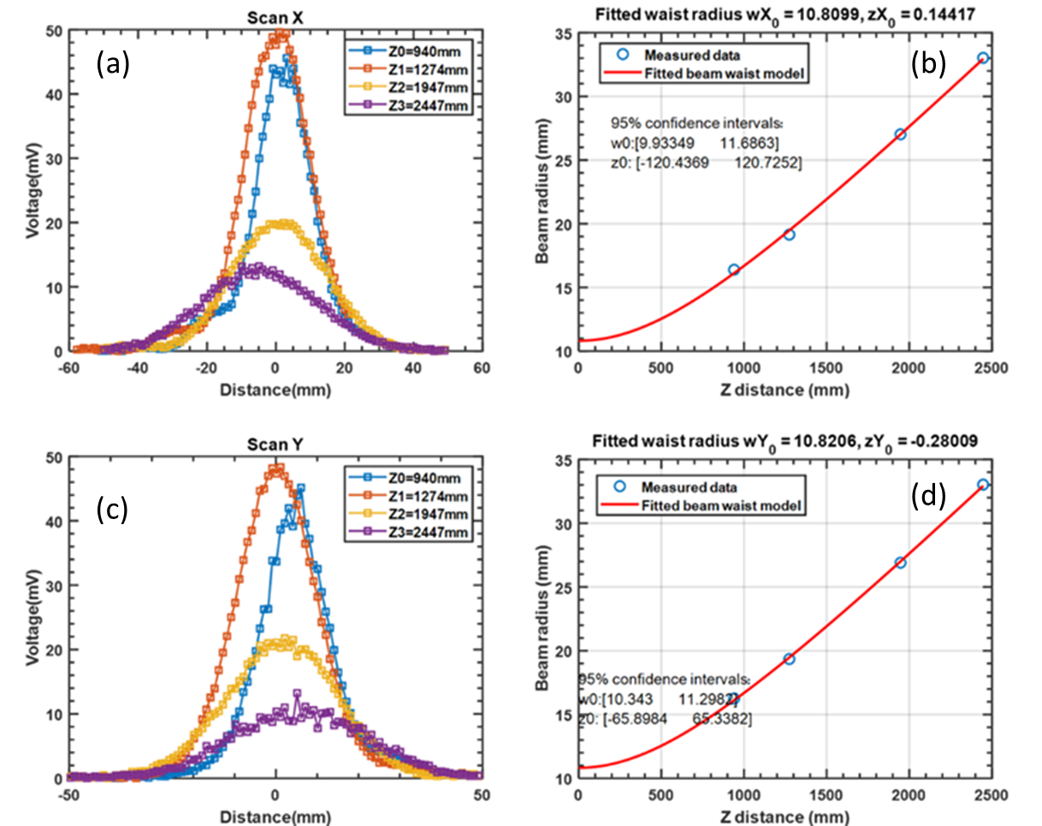
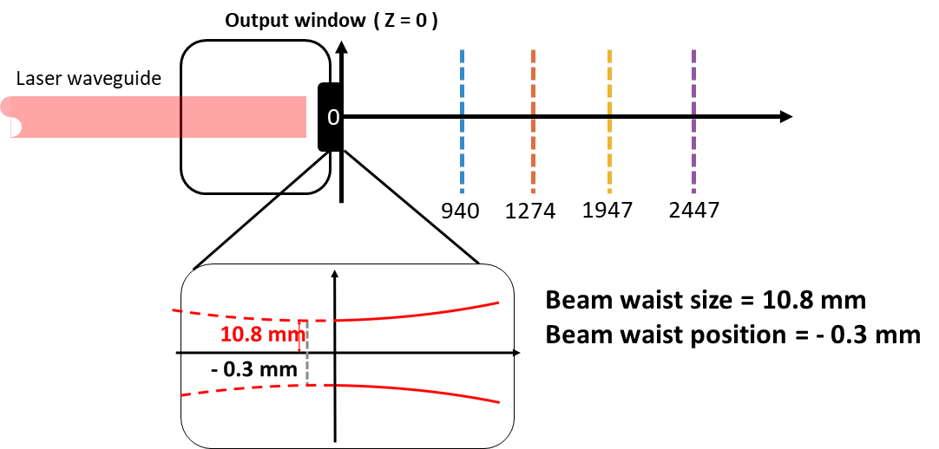
Horizontal power distribution
Gaussian fitting (horizontal)
Voltage (mV)
Power (a.u.)
Beam radius (mm)
Horizontal position (mm)
Distance from laser output window (mm)
Vertical power distribution
Gaussian fitting (vertical)
Voltage (mV)
Power (a.u.)
Beam radius (mm)
Vertical position (mm)
Distance from laser output window (mm)
(e)

Slide 16
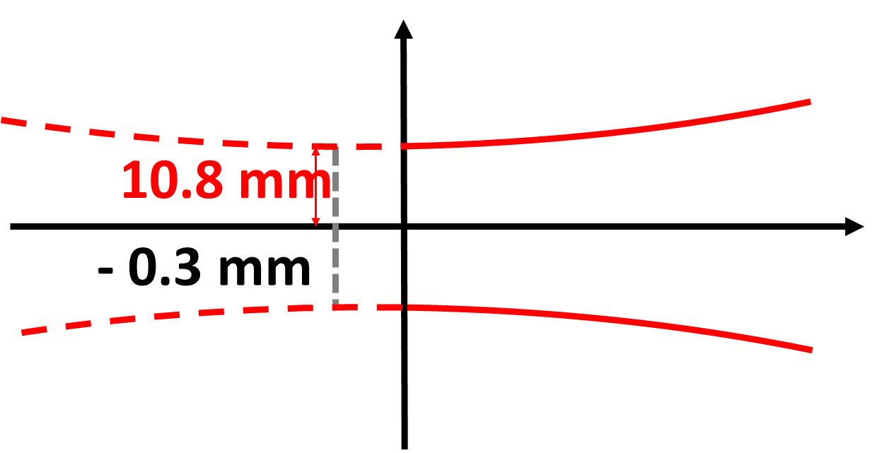
Output window ( Z = 0 )
Laser waveguide
0
940
1274
1947
2447
Beam waist size = 10.8 mm
Beam waist position = - 0.3 mm

Slide 17
10.8 mm
- 0.3 mm

Slide 19
Computer
Stepper motor stage
FIR laser power detector
FIR laser output
Cavity length

Slide 20
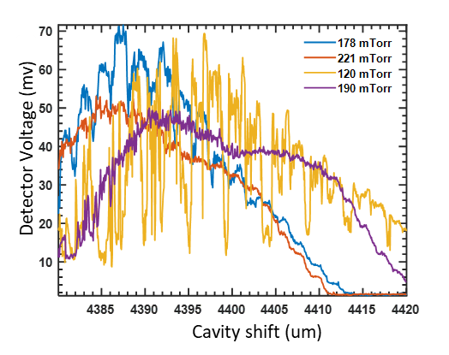
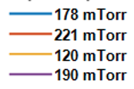

$Cavity shift (μm$)

Slide 21
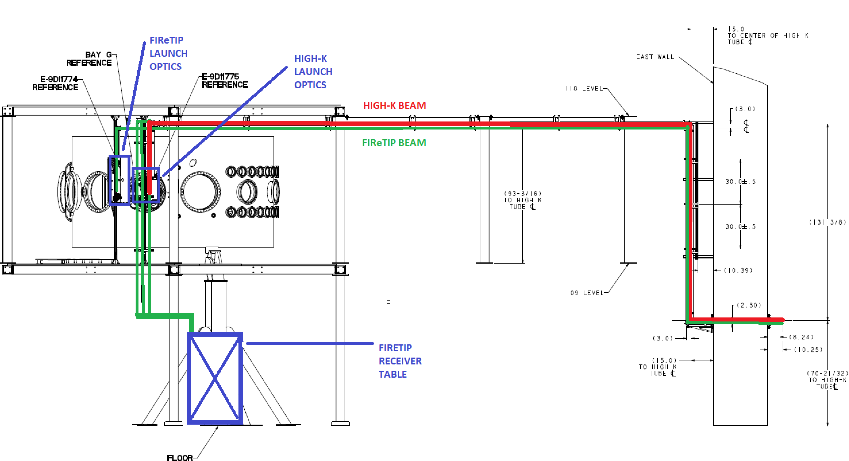
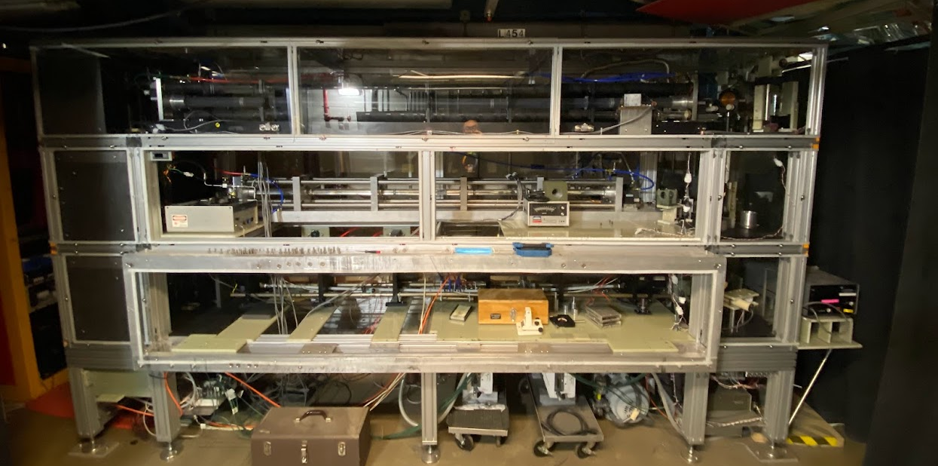
Transmission Line
NSTX-U Vessel
Laser Cage Area

